Slide 1

Project 4: Time Series Forecasting
Elvessa Tatum

Slide 2
Problem Statement
In this project, we aim to forecast future retail sales using historical sales data from product families sold at Favorita stores located in Ecuador.
Accurately predicting future sales is critical for effective inventory management, staffing, marketing campaigns, and strategic planning.
By applying time series forecasting models such as SARIMA, Prophet, and simple moving averages, we seek to identify patterns, seasonality, and trends that influence sales behavior over time.
The goal is to build robust models that minimize forecasting error and provide actionable insights for business decision-making.

Slide 3
About the Data
The dataset for this project comes from the Kaggle "Store Sales" competition. It contains detailed sales information from a major Ecuadorian grocery retailer across multiple stores and product categories.
Key features include:
date: The date of the sales transaction.
store_nbr: Unique identifier for each store.
family: Product category (e.g., beverages, dairy, produce).
sales: Total sales amount for the given date, store, and product family.
onpromotion: Number of products on promotion on that date.
The data spans several years and captures important sales patterns such as:
Seasonality (weekly and yearly shopping cycles), Holidays and promotions effects, Store-specific trends
For this project, we focus primarily on aggregated daily sales across all stores and product families to model overall retail sales trends and forecast future performance.

Slide 4
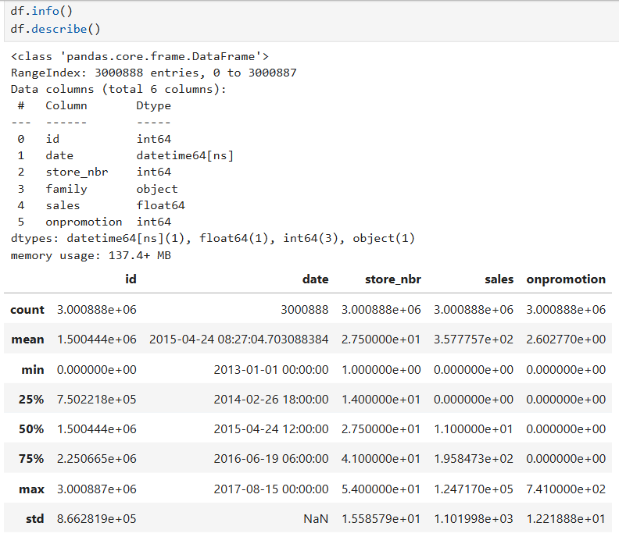
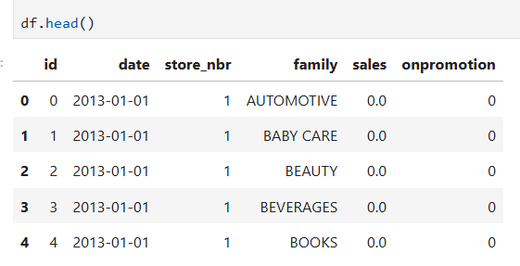
Importing Data
Let’s start by importing the data and taking a overview at it.

Slide 5
Hypothesis
I predict that more people will be buying on the weekends rather than the weekdays.
This means more buys on Sunday and Saturday compared to the other 5 days of the week.

Slide 6
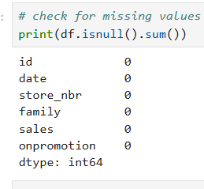
Pre-Processing Data
After seeing that there are no missing values, I decided to move on and extract time based features.

Slide 7
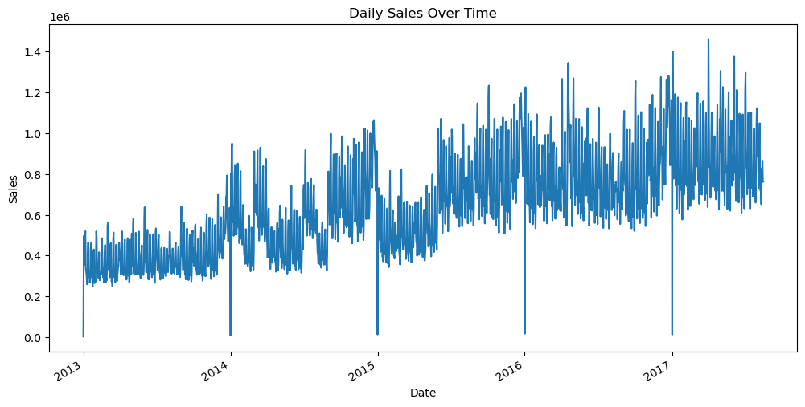
Data Exploration
Let’s take a look at the data a bit more. First, let’s take a look at the daily sales over time.
Clearly, the sales have gone up over time, reaching a peak in 2017.

Slide 8
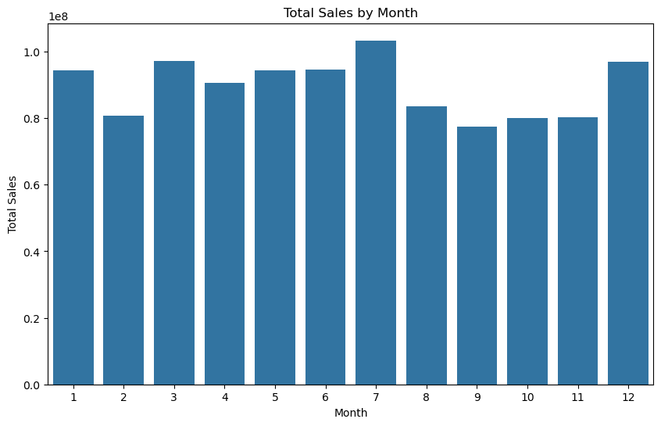
Data Exploration continued
Next, let’s check the total sales by month
Clearly, July is the highest, followed by December. Overall, the highest time period for sales seems to be in Spring and Summer (March-July)

Slide 9
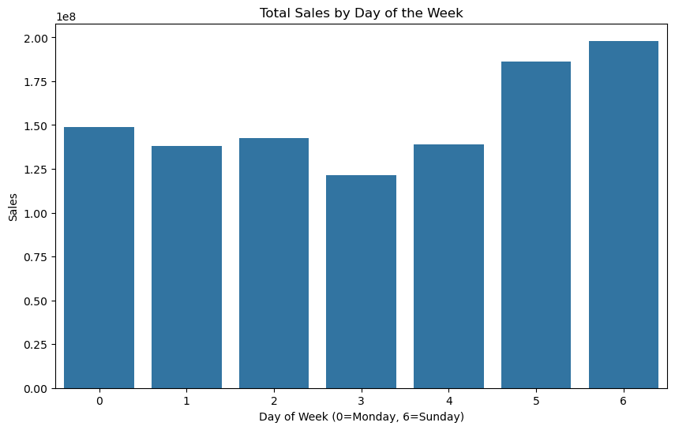
Data Exploration continued
Next, let’s see if my hypothesis was correct with the sales by days of the week.
Clearly, it was. The sales on Saturday and Sunday outdid the sales throughout the rest of the week.

Slide 10
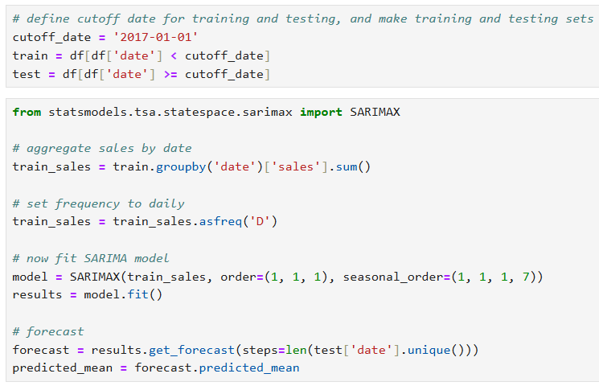
Creating our SARIMA Model
Now that we’ve explored the data, let’s make the SARIMA Model and view it.

Slide 11
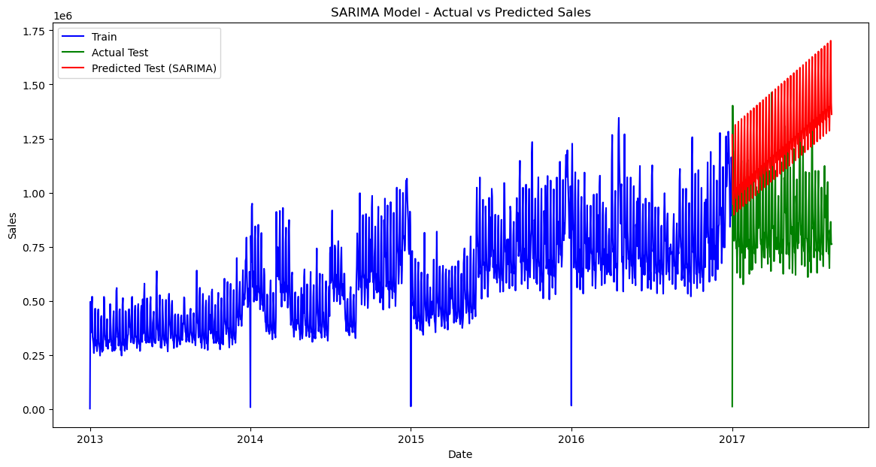
Creating our SARIMA Model Continued
Our Model predicted for sales to be way higher than they ended up being for the test sales.
This isn’t good, as the model should be more accurate to the testing set.

Slide 12
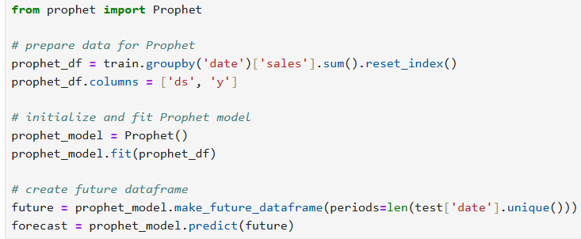
Creating Prophet Model
Next, let’s make the Prophet Model.

Slide 13
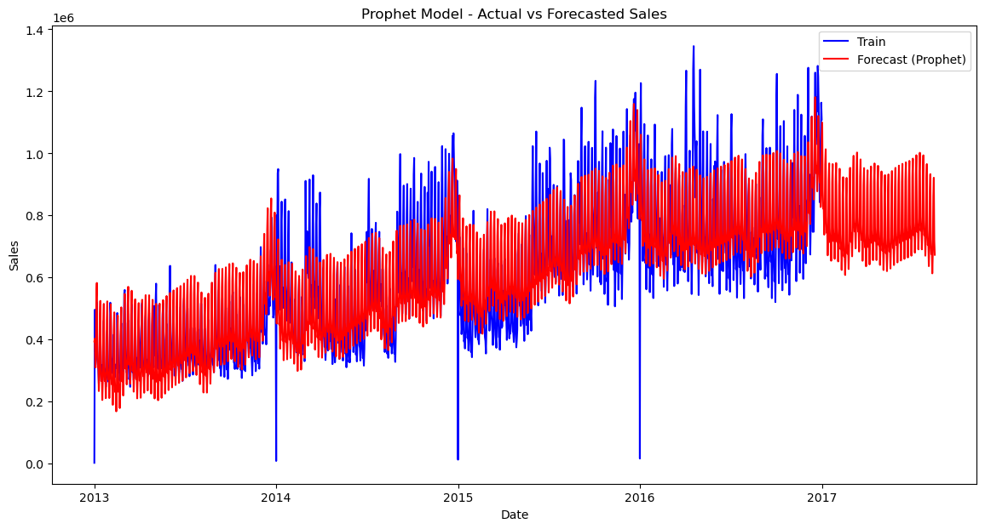
Creating Prophet Model Continued
Let’s take a look at the Prophet Model.
This model did much better, landing fairly close to the training data, and also having forecasts similar to the actual testing data we saw in the previous graph.

Slide 14
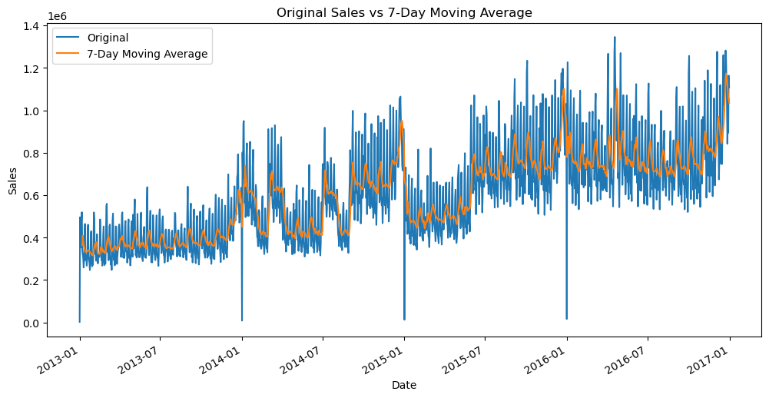
Moving averages
Finally, let’s take a look at the 7 day moving averages.
From here, we can see a general upward trend, reaching over a million dollars in sales.
However, there are some dips, particularly in January each year. This could just be seasonal slowdowns that happen each year.

Slide 15


Evaluating models
Let’s evaluate the models now, first the SARIMA model then the Prophet model. We’ll do this by calculating RMSE, MAE, and MAPE for each model using the test set.
Here, Prophet has MUCH lower RMSE. This means that Prophet predicts closer on average.
Again, Prophet has much lower MAE. This means that Prophet has smaller average errors.
Finally, SARIMA had a 94% MAPE, while Prophet had s 49% MAPE.
Clearly, Prophet was the better model by far.

Slide 16
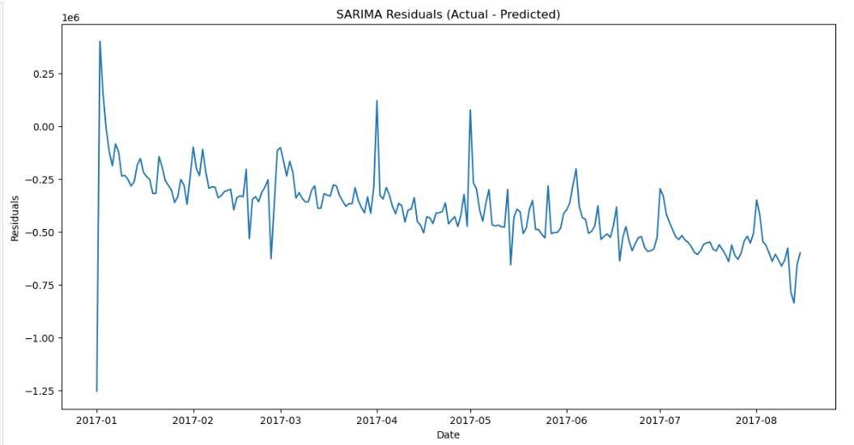
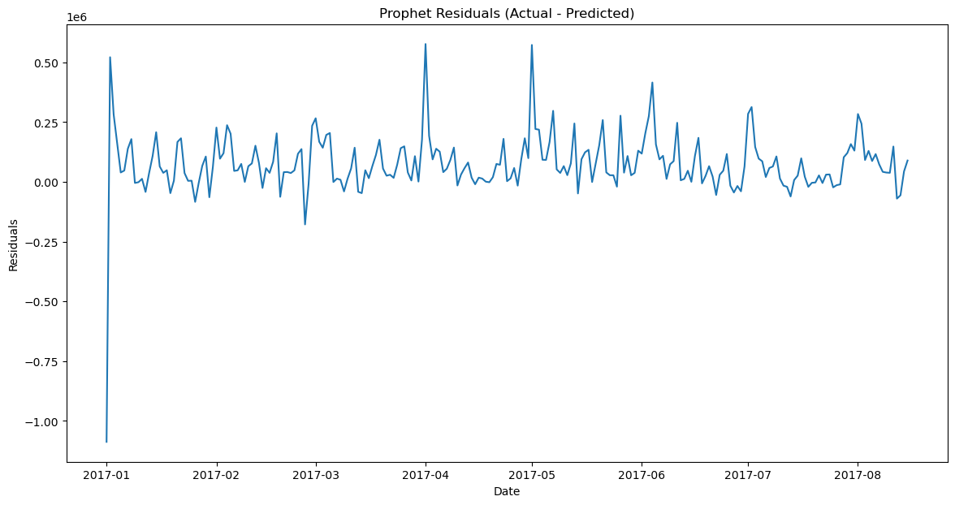
Evaluating Models Continued
Now, we’ll take a look at the residuals for the two models
Prophet had some spikes, but overall wasn’t too bad.
Meanwhile, SARIMA was constantly going down, meaning it consistently overestimated the actual sales values

Slide 17
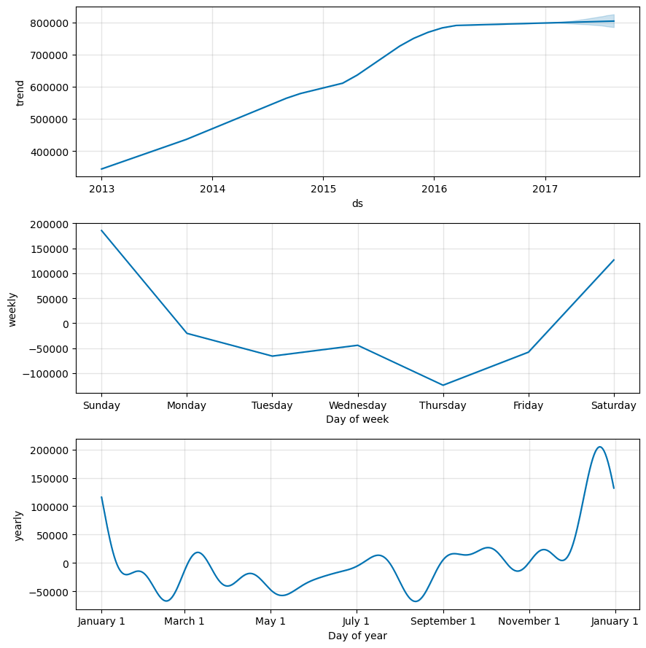
Evaluating Models Continued
Finally, let’s look at the seasonality for the prophet model.
The lowest day of the week seems to be Thursday, while the best day is Sunday.
Meanwhile, The worst month seems to be September, which is supported by the total sales by month graph we saw earlier.

Slide 18
Conclusion
After training and evaluation, the Prophet model significantly outperformed the SARIMA model across all evaluation metrics:
Prophet achieved a lower RMSE, MAE, and MAPE compared to SARIMA.
The SARIMA model showed high forecasting errors, with a MAPE of approximately 95%, indicating it struggled to capture the underlying patterns in the sales data.
In contrast, the Prophet model achieved a MAPE of approximately 49%, suggesting much better predictive performance, although there is still room for improvement.
We were also able to see that the best day was on Sunday, while the best month was July. This information can be used to make more sales around those time periods.

